Slide 1

Merge + Insertion sort
SCSF – lab 1 Team 3:
Siah Yee Long
Wang Anqi
Matthew Heng

Slide 2
Contents
Introduction
Pseudocode of the merge + insertion sort algorithm
Code set up:
Generation of random array with size N
Logging elapsed time
Recording of key-comparisons and execution time performance
Evaluation of performance
Time complexity for best, worst, average
Fixed S, key comparisons vs n
Fixed n, key comparisons vs S

Slide 3
Introduction – merge sort overview
Size = 1

Slide 4
Introduction – hybrid sort overview
Size = S
Conduct insertion sort

Slide 5
Pseudocode
hybrid_sort(arr, S)
// this will be a recursive function
{
if (len(arr) > S) {
// conduct merge sort routine on arr
hybrid_sort(left_half, S)
hybrid_sort(right_half, S)
// merge the two sorted halves, smallest possible size of the halves would be S
merge(left_half, right_half)
return (sorted sub-arr)
}
else {
// if length of array <= S
conduct insertion sort routine on arr
return (sorted sub-arr)
}
}

Slide 6
Code set up
Generation of random array with size N
Logging elapsed time
Recording of key-comparisons and execution time performance

Slide 7

Generation of random array with size N
Generate our own input data sets, ranging from 1000 to 10,000,000 random integers.

Slide 8

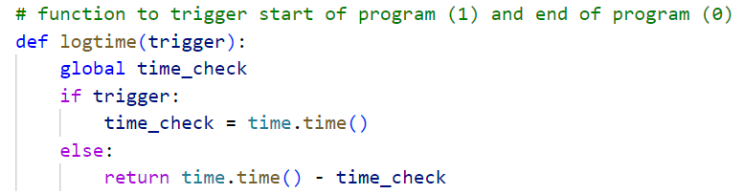
Logging elapsed time

Slide 9
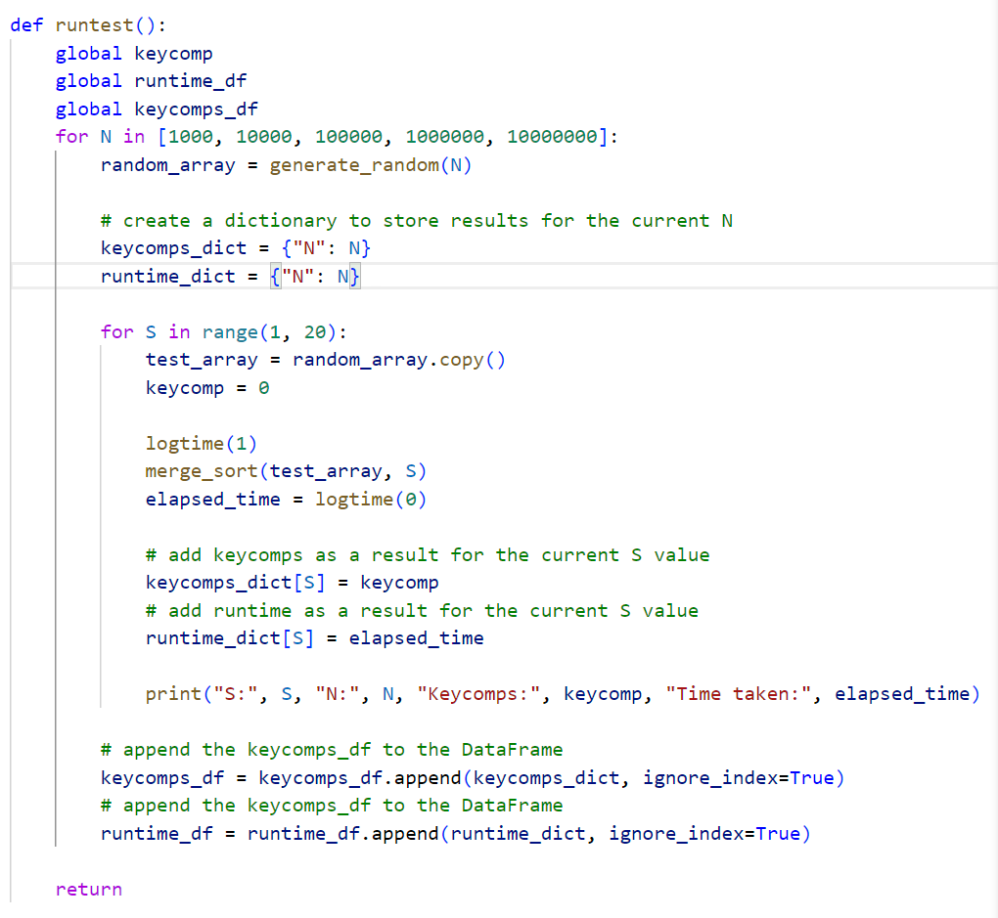

Slide 10
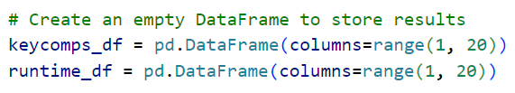
Recording of key-comparisons and execution time performance

Slide 12
Evaluation of performance
Time complexity for best, worst, average
Fixed S, key comparisons vs n
Fixed n, key comparisons vs S

Slide 13

Time Complexity

Slide 14







Time complexity of Hybrid Sort?
ALGORITHM
BEST
AVERAGE
WORSE
O(N)
O(N²)
O(N²)
$$O\left(N\right)$$
$$O(N^{2})$$
$$O(N^{2})$$
Insertion Sort
$$O(N\log{N})$$
$$O(N\log{N})$$
O (JON
$$O(N\log{N})$$
Merge Sort
$$?$$
$$?$$
$$?$$
Hybrid Sort

Slide 15



Visualization of Time Complexity – Hybrid Sort – Worse Case
Worse-case hybrid = worse case insertion sort + worse case merge sort
Height = log(N/S)
N
N/2
N/2
N/4
N/4
N/4
N/4
S
S
S
S
S
S
S
S
Insertion Sort : $S^{2}∗ \frac{N}{S}=NS$
Merge Sort : $N ∗log\left(\frac{N}{S}\right)$
Hybrid Sort: $O\left(NS+Nlog\left(\frac{N}{S}\right)\right)$

Slide 16
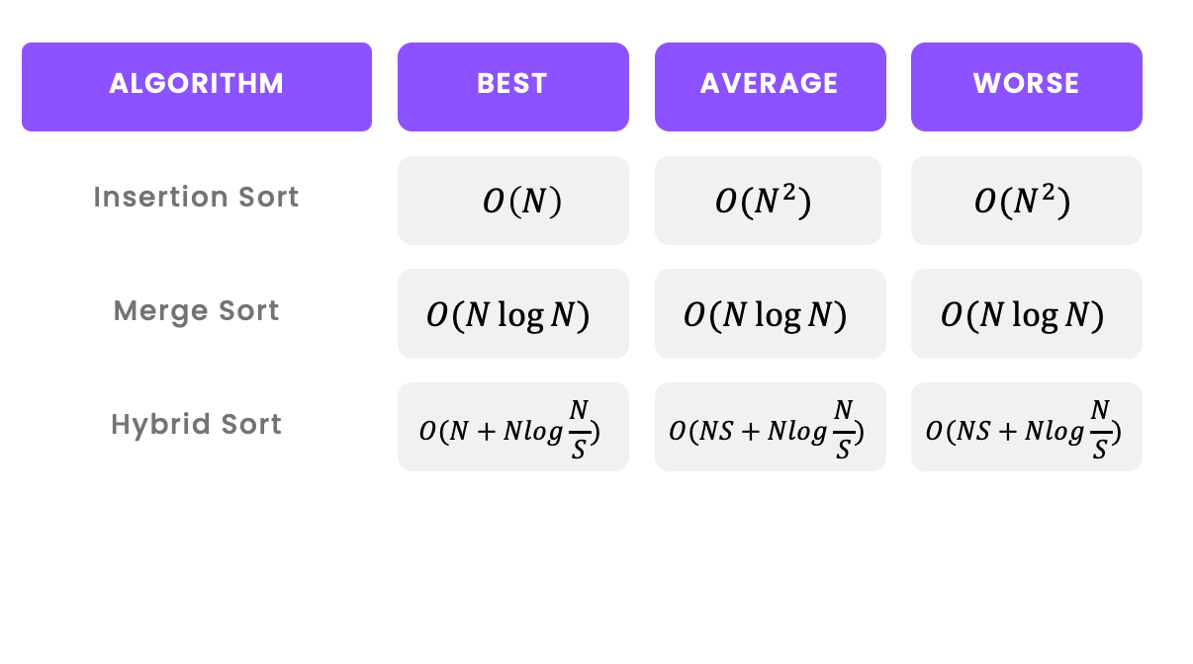
Time complexity for best, worst, average

Slide 17
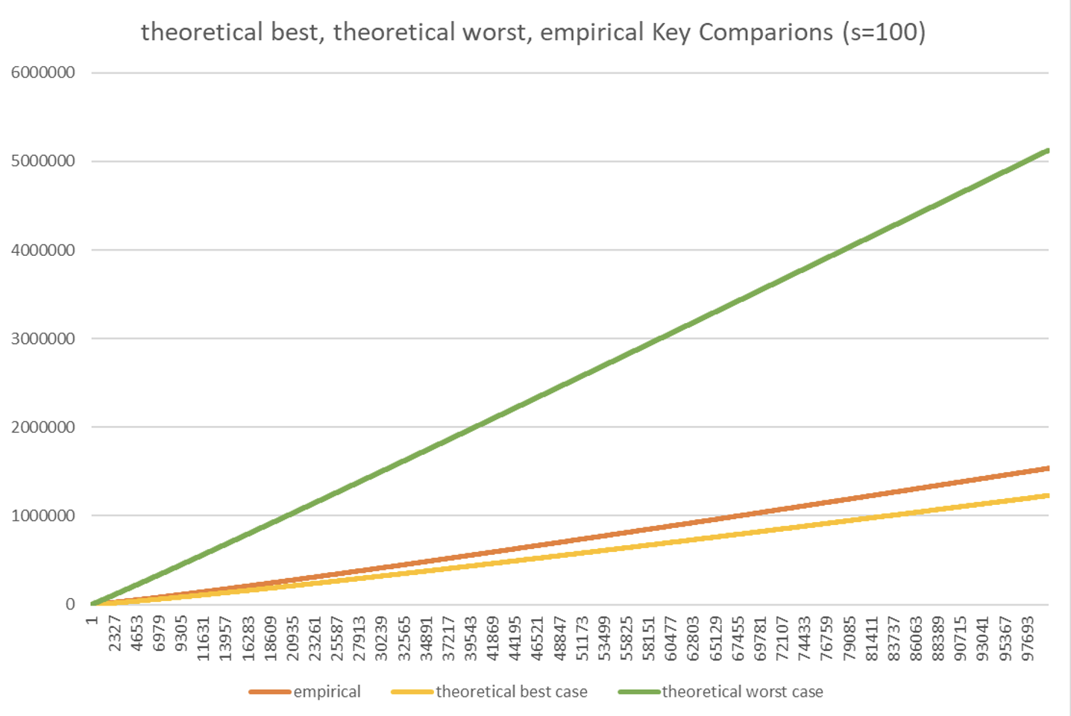

C i)
S = 15
N = [1 – 100k]
Analysis:
The empirical time complexity is close to the theoretical best case
Empirical curve is bounded by theoretical worse and best
$$+N$$

Slide 18
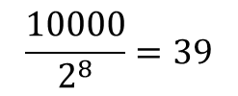
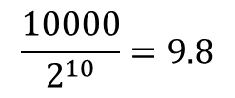
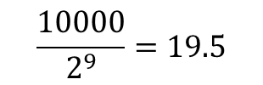
c ii)
N = 10000
S = [1 – 60]
Analysis:
Empirical curve is bounded by theoretical worse and best
Different shape of curve (stepped curve)
$$\frac{10000}{2^{10}}=9.8$$
$$\frac{10000}{2^{9}}=19.5$$
$$\frac{10000}{2^{8}}=39$$

Slide 19
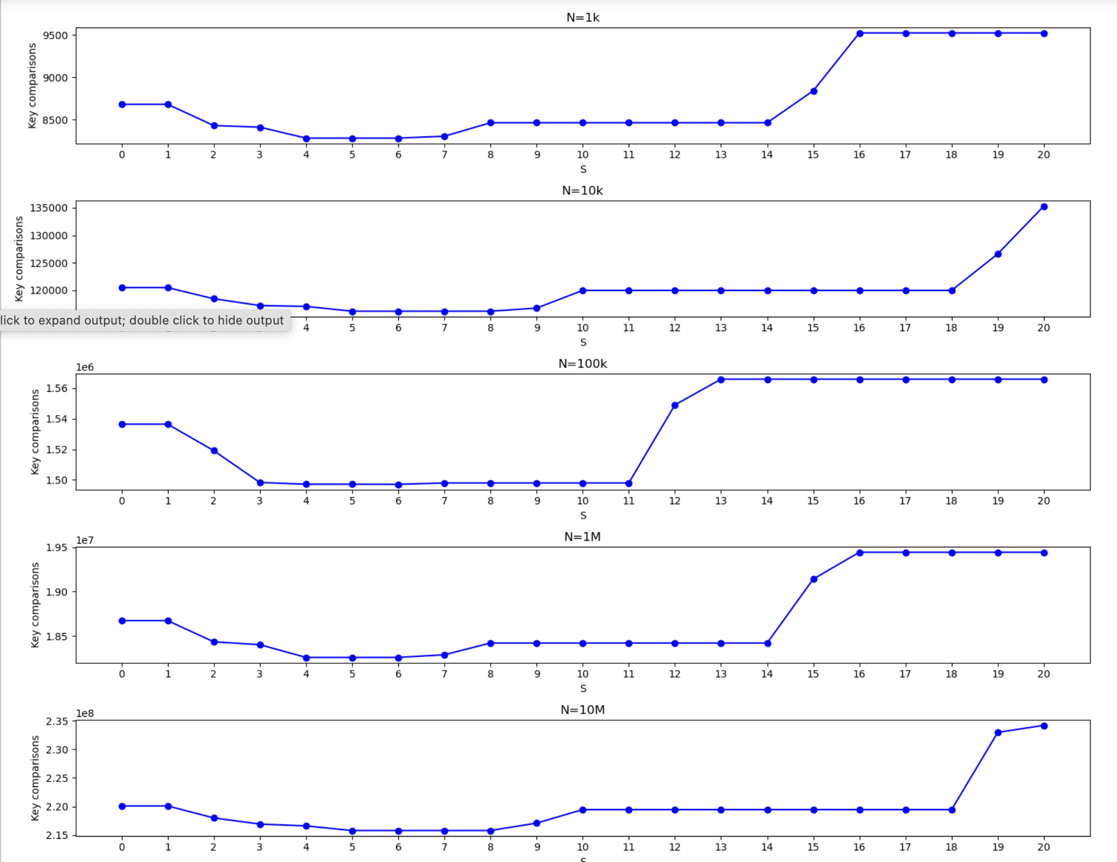
C iii)
Optimal S = 5

Slide 20
d) Merge sort vs Hybrid sort
N = 10M, S = 5 | Key Comparison | CPU run time (s)
Merge Sort | 220,100,914 | 52.7952
Hybrid Sort | 219,187,695 | 47.8992
Iterate 100 times to get the average value
CPU time difference = 4.896 s (Hybrid sort faster)
CPU performance: Hybrid sort is 9.27% more efficient than Merge sort
Key comparison difference = 913219 (Hybrid sort lesser)
Key comparison performance: Hybrid sort is 0.41% more efficient than Merge sort

Slide 21
Thank you!

